Slide 1
The Notion of Software Quality
This document © 2003-2018 Prof. Ernest Cachia
Edited by Dr Mark Micallef

Slide 2
Software Engineering
“the application of a systematic, disciplined, quantifiable approach to the development, operation, and maintenance of software, that is, the application of engineering in software” – IEEE, 2001

Slide 3
The Meaning of Quality (Is there one?)
In general:
“A distinctive attribute or characteristic”…“the degree of excellence of something as measured against other similar things” – Oxford Online.
“A peculiar and essential character”…“An intelligible feature by which a thing may be identified” – Merriam Webster Online.
Software quality:
“Conformance to explicitly stated functional and performance requirements, explicitly documented development standards, and implicit characteristics that are expected of all professionally developed software” – Pressman, R.

Slide 4
What makes quality software?
Inexpensive?
Reliable?
Testable?
Secure?
Maintainable?
…

Slide 5
Is this a quality car?

Slide 6

Is this a quality car?

Slide 7
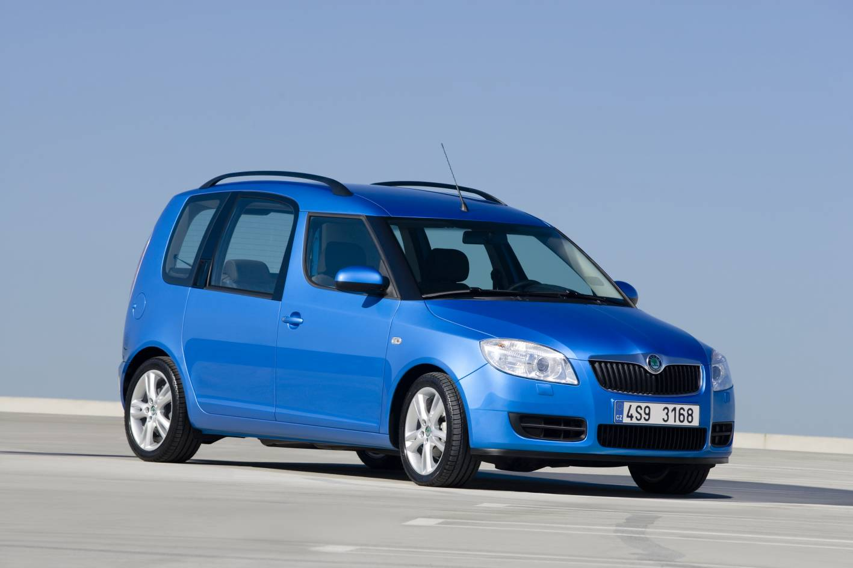
Is this a quality car?

Slide 8
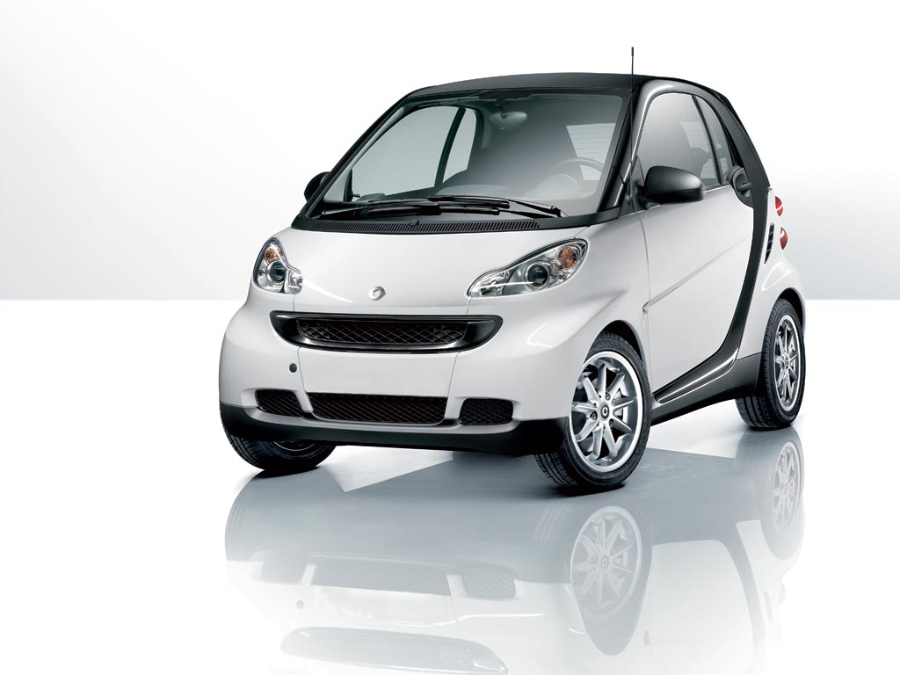
Is this a quality car?

Slide 9
What makes quality software?
There is not clear-cut answer
It depends on:
Stakeholders
Type of system
Type of users
…
Quality is a
multifaceted concept
Different ideas about a quality car

Slide 10
Different Quality Scenarios
Online banking system
Security
Correctness
Reliability
Air Traffic Control System
Robustness
Real Time Responses
Educational Game for Children
Userfriendliness

Slide 11
Software Quality
Software Quality Considerations
Product (solution) quality is dependent on process quality
Quality control must be an ongoing process
Quality is a direct result of good (i.e. correct) management
Quality depends on the type of system in question
Quality can be viewed as an internal or external property

Slide 12
Attempting to qualify software
This is not a straightforward issue due to such facts as:
Very difficult if approached un-scientifically
Various factors effect it (i.e. must be considered)
There are multiple facets to a s/w product
Very easy to qualify “incorrectly”
There is considerable subjectivity in a s/w product
A s/w product may be prone to changes

Slide 13
Some Generic Software Aspects
Software quality can be characterised by its:
The development process
End-products (with all their representative attributes)
Interaction with humans (users, developers, process managers, vendors, etc.)
Relation to the real-world process it is to implement
Reviews and/or feedback (relating to the product).

Slide 14

Quality cannot be an “add-on”
A wishful
quality product
]
A product
Produce
Becomes
Developers
Inject
This step is a misconception
Quality

Slide 15

Quality Must Permeate
Requirements
Standards
Management
Produce
An actual
quality product
Developers
& their tools
& methods
Tools
Methods

Slide 16
The Actual Meaning of Quality
Quality means different things to different people. Consider the following:
For the user (reliable, efficient, user-friendly, etc.)
For the producer (maintainable, verifiable, portable, etc.)
For the manager (measureable, visible, controllable, etc.)
For the client (cost-effective, interoperable, effective, etc)
For the vendor (value-for-money, relevant, timely, etc)
The main two categories of s/w qualities are:
External (qualities observable from “outside” the system)
Internal (qualities pertaining to internal system aspects)

Slide 17
The Process Makes the Product
Process: “A series of activities undertaken to achieve a stipulated entity”
Product: “An entity resulting from a given process”
Quality applies to both process and product
A software product can (typically) consist of:
The executable system
Installation guides
User manuals
Application documentation
User training plan/requirements
System cross-over and data migration strategies
Testing justification and logs
Etc.

Slide 18
Classification of Software Systems
A general system classification could be as follows:
Information/Business (Batch-Processing)
On-line
Real-time
Embedded
Distributed
Quality for each of the above can have a different meaning.

Slide 19
Information (Business) Systems
Main elements:
Data
Database
Transaction
Security
Important aspects:
Data integrity
Data availability
Data security
Transaction efficiency
Transaction 1
Transaction 2
.
.
Possible further
processing and
remote storage
.
Pre-processing
and local storage
Transaction n

Slide 20
On-line Systems
Main elements:
Result time limits
Time-slicing
Security
Important aspects:
Response time range
Stimuli to results
relationships
Communication
design/security
HCI design
Terminal 1
Terminal 2
.
.
Further
processing and
remote storage
.
Local switching
(little of no processing)
Terminal n

Slide 21
Real-Time Systems
Main elements:
Stringent timing
Control
I/O specifications
Safety
Important aspects:
Response time
System size & complexity
Control protocol design
Safety mechanisms
HCI and MMI design
User control
Panel/s
Controlling
computer
Controlled
device/s
Controlled
device/s
Controlled
device/s

Slide 22
Embedded Systems
Main elements:
Stringent timing
Control
I/O specifications
System dependency
Safety
Important aspects:
Response time
System size & complexity
Control protocol design
Safety mechanisms
Sensory feedback loops
MMI design
system being controlled
Internal
control
Software
component

Slide 23
Distributed Systems
Main elements:
Process communication
Process distribution
Data distribution
Network links
Important aspects:
Communication protocols &
bandwidth
Logical to physical process
(and data) mapping
Process dependency & sync.
Data redundancy
Process 1
Process n
Computer or
processor 1
Computer or
processor n
Process 2
All doing 1
task
Computer or
processor 2

Slide 24
Some Software Process & Product Quality Attributes
Correctness (int/ext/prd)
Security (ext/prd)
Reliability (ext/prd/prc)
Robustness (ext/prd/prc)
Efficiency (ext/prd/prc)
User friendliness (ext/prd)
Verifiability (int/prd)
Maintainability (int/prd/prc)
Reusability (int/prd)
Portability (ext/prd)
Understandability (int/prd)
Interoperability (ext/prd)
Productivity (prc)
Timeliness (prc)
Visibility (prc)
Manageability (prc)
“ext”- external quality; “int”- internal quality
“prd”- product quality; “prc”- process quality

Slide 25
Correctness (int/ext/prd)
Does the system do the right thing?
At the basis of many other s/w qualities
E.g. Reliability and Robustness
Relative to s/w functional specifications
Must show equivalence between s/w and its specification
Experimental (through testing)
Analytical (through formal verification)

Slide 26
Security (ext/prd)
Can the system be trusted?
An important consideration
A major security incident would be devastating to a business’ reputation
Four main challenges
Confidentiality/Secrecy
Authentication
Integrity
Non-Repudiation

Slide 27
Security → Confidentiality/Secrecy
aaTTyUIjhg^&bvv$%vDDDg*$$$csdad
sa@@!%&&dds#FFDE33@”:{}{PIHJGFs
Intercepts
But cannot
Understand
messages
James
Peter
????
Always assume that anyone can view
your electronic communications at will.
Evil Hacker

Slide 28
Security → Authentication
Hello James, this is Peter I have information 4u
Intercepts
James
Peter
Hello Peter, I am James.
Give me the information.
Evil Hacker

Slide 29
Security → Integrity
Hello James. Please give me your account num
Ok. My account number is 332121221
Intercepts
and
Modifies
Message
James
Peter
Ok. My account
number is 55421221
Evil Hacker

Slide 30
Security → Non-Repudiation
Do you want this product?
Yes
Evil Shopper
Peter
Sent it to you. Pay me.
Sent what? I didn’t ask for anything.
Non-repudiation means a participant in a transaction cannot deny that (s)he sent a message.

Slide 31
Reliability (ext/prd/prc)
Is the system dependable? Is its production consistently acceptable?
In it’s complete form, considered to be “ideal”
Guarantees non-existant / disclaimers many
Assumes correctly specified requirements

Slide 32
Robustness (ext/prd/prc)
Does the system have a margin of tolerance? Is its production flexible?
Refers to the system’s function/performance above and beyond its specifications
Not a specifiable quality

Slide 33
Efficiency (ext/prd/prc)
Is the system helpful?
Tends to follow directly from reliability and robustness
Effects system scalability
Generically measured in terms of extremes of algorithm time/space/etc requirements
Should be addressed BEFORE system implementation

Slide 34
User Friendliness (ext/prd)
Is the system pleasant and conducive to use?
Highly subjective
Depends on the type of user
Not just UI related –
E.g. How easy is the system to configure?
E.g. How smoothly does the system perform?
GUI Design should be taken seriously
Accessibility is becoming increasingly important
Standardisation helps increase user friendliness

Slide 35

User friendliness aspects
Please note THREE MAIN types of users
The System
The “normal” user
The “Operator” user
The “experienced” user

Slide 36
Maintainability (int/prd/prc)
Is the system easy to alter and/or upgrade? Is its production adaptable?
Maintenance eats up around 65% to 75% of total s/w dev costs
Existing software does not “wear out” – it evolves
Not akin to hardware maintenance
Software maintenance can be classified as:
Corrective (sorting out persistent errors – 25%)
Adaptive (due to changes in the working environment – 20%)
Perfective (improve system functionality – 55%)
Why is process maintainability important?

Slide 37
Reusability (int/prd)
Has the system been built based on past experience/effort?
Using existing products to construct new ones
Important but not often used/appreciated
Results in cheaper, more effective development
Some examples:
Language APIs (e.g. Microsoft WCF, Java Swing)
Third-party routines, widgets, etc (e.g. Apache Commons)
Considered to be an indicator of organisational maturity

Slide 38
Internal and external reuse
Internal Reuse
Refers to software developed and used by the same people working on the same application.
External Reuse
Software developed for reuse external to the organisation or external to the application being developed.

Slide 39
Benefits gained by reuse
Lower development costs
Higher productivity (reduced cycle time)
Lower training costs
Easier maintenance
Lower risk (higher reliability)
Better interoperability
Better portability
Reusable components might sacrifice efficiency in favour of generality

Slide 40
Portability (ext/prd)
Can the system work across computing platforms/environments?
Increasingly important in today’s world of smart phones, devices, browsers, OSs, etc
Technology-dependent
Can be partially achieved through reuse
Could entail trade-offs in the form of non-optimal usage of resources/features

Slide 41
Understandability (int/prd)
Is the way the system was built and its logic easy to understand?
Has a direct impact on other software qualities
E.g. Maintainability
E.g. Correctness

Slide 42
Interoperability (int/prd)
Can the system work well in conjunction with other systems?
E.g. Can VPN software talk to VPN systems from other vendors?
E.g. Can my flight booking system talk to all airlines?
E.g. Can this reporting system use data from all my other existing systems?
Related to standardisation

Slide 43
Productivity (prc)
How stable and competitive is the production?
How do you measure productivity?
Lines of code??
Features??
This will be covered in a future lecture
Reuse affects productivity
Process maturity affects productivity

Slide 44
Timeliness (prc)
How mature and controlled is the production to ensure timely delivery?
Related to productivity but is not the same
Related to requirements management
Related to stakeholder management

Slide 45
Visibility (prc)
How clearly is the production life-cycle structured?
How easy is it to monitor progress?
Synonymous with transparancy
Very difficult to achieve without the right mentality
“Go away and let me work” syndrome

Slide 46
Manageability (prc)
How well defined are all the stages and meta-products in the life-cycle?
How easy is it to “manage” the process
Related to visibility but not the same

Slide 47
Briefly on Each Attribute (1/3)
Correctness
Does the system do the right thing?
Security
Can the system be trusted?
Reliability
Is the system dependable? Is its production consistently acceptable?
Robustness
Does the system have a margin of tolerance? Is its production flexible?
Efficiency
Is the system helpful? Is its production well controlled?
User friendliness
Is the system pleasant and conducive to use?

Slide 48
Briefly on Each Attribute (2/3)
Verifiability
Is the system easy to verify in correctness and in required function?
Maintainability
Is the system easy to alter and/or upgrade? Is its production adaptable?
Reusability
Has the system been built based on past experience/effort?
Portability
Can the system work across computing platforms/environments?
Understandability
Is the way the system was built and its logic easy to understand?

Slide 49
Briefly on Each Attribute (3/3)
Interoperability
Can the system work well in conjunction with other systems?
Productivity
How stable and competitive is the production?
Timeliness
How mature and controlled is the production to ensure timely delivery?
Visibility (prc)
How clearly is the production life-cycle structured?
Manageability (prc)
How well defined are all the stages and meta-products in the life-cycle?

Slide 50
Conclusions
Software Quality is Multi-Faceted
The question “Is the product good enough for release?” is heavily loaded
Go home, digest and internalise the content of this lecture such that it affects the way you think about software when developing it.

